Slide 1
GIT Source Control Management
First Steps

Slide 2
What is GIT?
Distributed source code management
Emphasis on speed
Developed by Linus Torvalds
Used by Linux Kernel (Over 14 millions lines of code)

Slide 3
Birth of GIT
2002
Linux Kernel uses BitKeeper
Everything was fine
April 6, 2005
BitKeep drops free license :(
Linus begins to write his own SCM
April 18, 2005
First merge
December 21, 2005
1.0 release

Slide 4
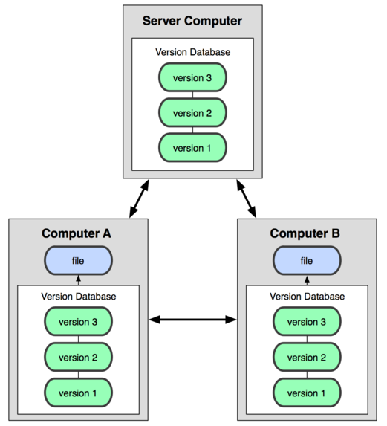
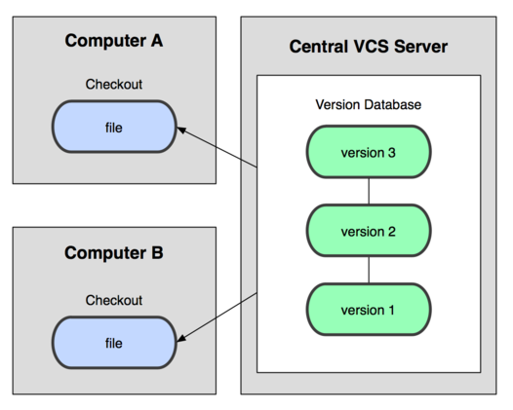
Centralized X Decentralized
Centralized
Decentralized

Slide 5
GIT advantages
Advanced branching and merging support
Speed
Doesn’t duplicate code
Offline commiting
Flexible (can work in a centralized way)

Slide 6


Slide 7
Thinking like GIT
Start from scratch (without SCM)
Backup a project:
$cp –R project project.bak
Backup project (paranoid):
$cp –R project project.2011-11-11.bak
Sharing:
$unzip project.2011-11-11.zip
$cp –R project.2011-11-11 my.project
$cd my.project
... Do some work ...
$diff my.project project.2011-11-11 > change.path

Slide 8
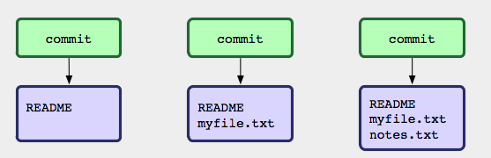
Thinking like GIT

Slide 9
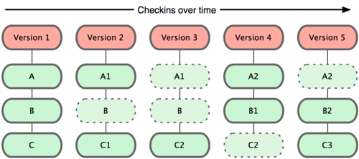
Thinking like GIT
Snapshots

Slide 10
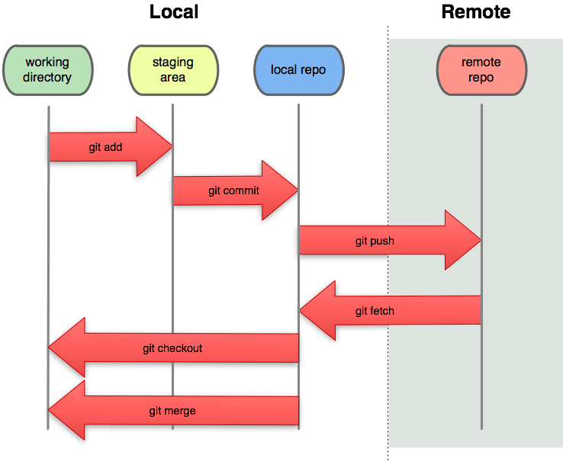
GIT workflow

Slide 11
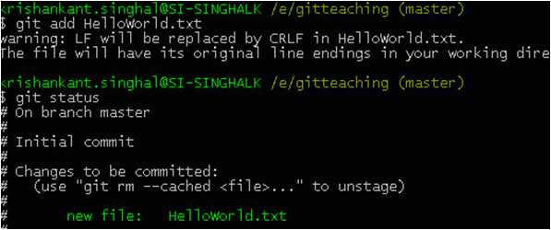
Basic commands and operations

Slide 12
Init
Types of repository:
Normal:
Project directories and files (working tree) + “.git” directory
Command: $git init
Bare:
Just the “.git”
Avoid confusion when sharing code
Command: $git init --bare

Slide 13

Add
Add files to the staging area before commit
Files already added -> “tracked”
Scenario:
Untracked file -> $git add file -> Add file current state to staging area
Tracked file
Modified file -> $git add file -> Add modifications to the staging area
Unmodified -> $git add file ->

Slide 14



Add
Initializing blank repository and created 2 files
Adding files
Modifying file again

Slide 15
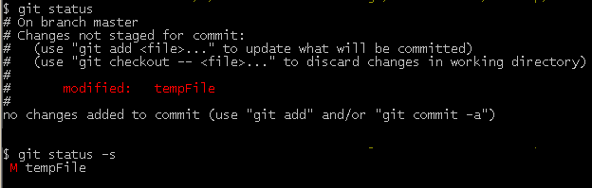

Status
View status of the working directory and staging area
$git status
$git status -s
?

Slide 16
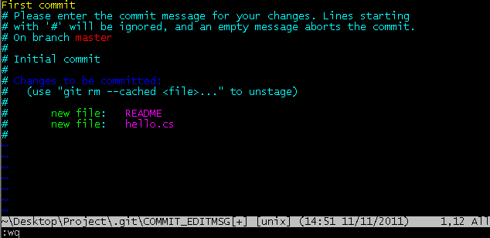


Commit
Record a snapshot of the staging area -> $git commit

Slide 17
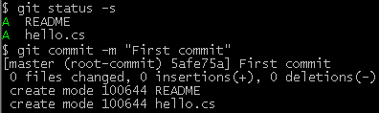
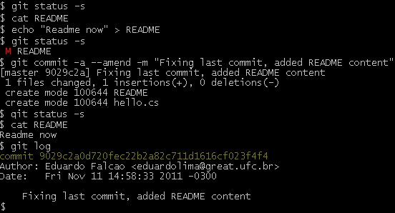
Commit
More parameters:
“-m”
“-a”
“--amend”

Slide 18
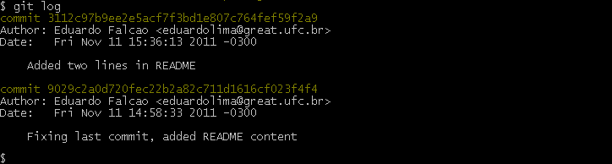
Log
Filter your commit list -> $git log
More parameters
$git log --author=“Eduardo”
$git log --oneline -15
$git log --before={3.weeks.ago} --after={2010-04-18}

Slide 19
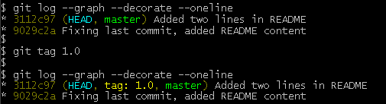
Tag
Tag a point in history as important -> $git tag tagname
Lightweight tag X Annotated tag (“-a” parameter)

Slide 20
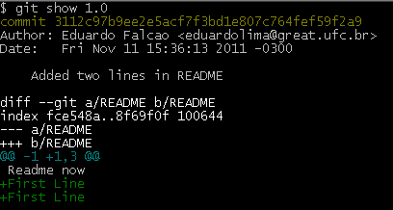
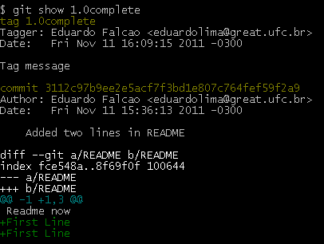
Tag
Lightweight tag X Annotated tag
$git tag -d tagName -> Delete tag
$git tag -> List tags
$ git tag -a tagname 9fceb02 -> Tagging later, in this case tagging commit 9fceb02

Slide 21


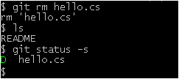
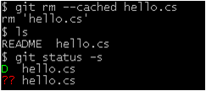
Rm, mv
Rm -> remove files from the staging area
git mv = $git rm --cached orig; $mv orig new; $git add new

Slide 22

Hands on!
Tasks
Create a directory called “mygit” and initialize a git repository
Create two files (“fileOne” and “fileTwo”) and add some text to them (do not add to the staging area)
Verify the repository status and interpret the result
Add these files to the staging area and verify their status
Modify “fileOne” file and verify its status (it will become something like AM)
Add all files and commit
Add an annotated tag and list its details
Modify “fileOne” again and “amend” to the last commit
View the log of commits
Remove “fileTwo” from the staging area but not from working dir
Verify the repository status
Commit with “-a” parameter

Slide 23
Diff
Describing changes
$git diff -> Between working directory and staging area
$git diff --cached -> Between staging area and HEAD
$git diff HEAD -> Between working directory and HEAD
$ git diff branch1..branch2 -> Between the two branches

Slide 24
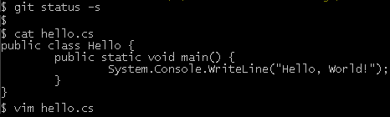
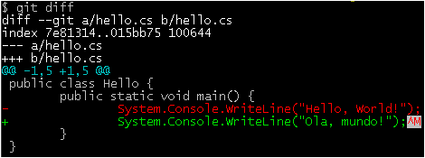
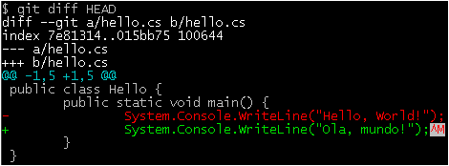
Diff
Describing changes

Slide 25

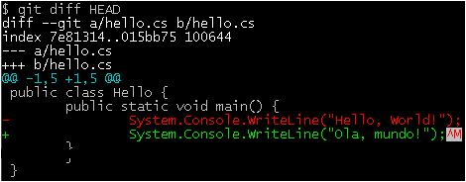

Diff
Describing changes

Slide 26
Branch, checkout
Managing working contexts
$git branch -> List local branches
$git branch –r -> List remote branches
$git branch branchname -> Create a new branch
$git branch –d branchname -> Delete branch
Switch branch context
$git checkout branchname -> Switch to the specific branch (if exists)
$git checkout –b branchname -> Create a branch and checkout (only if the branch does not exist)

Slide 27
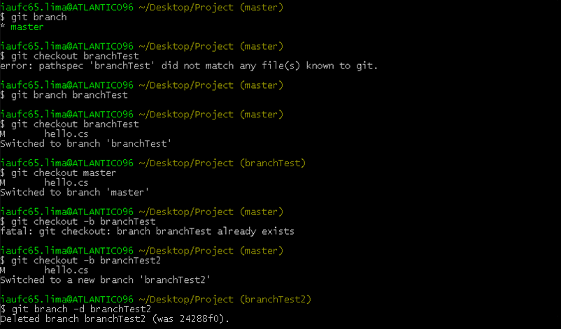
Branch, checkout

Slide 28
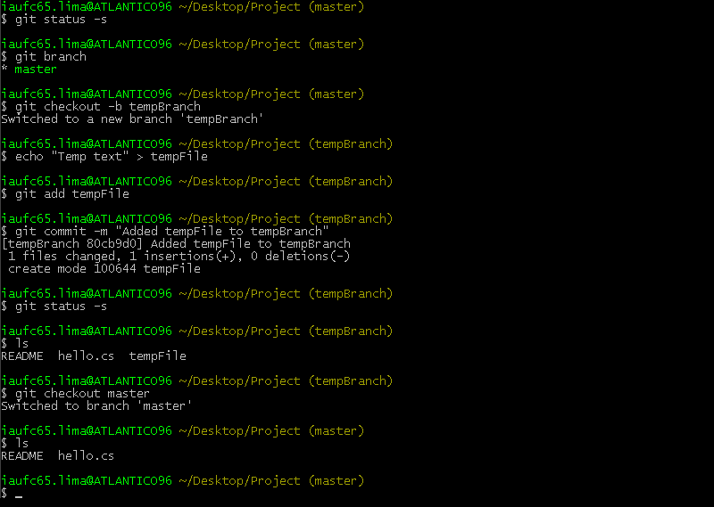
Branch, checkout

Slide 29
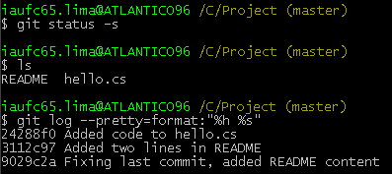
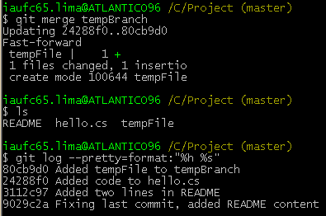
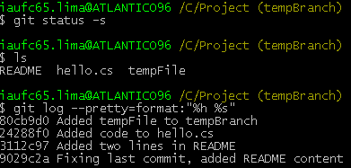
Merge
Merging working contexts - $git merge (branchname)

Slide 30
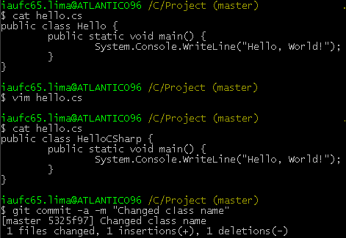
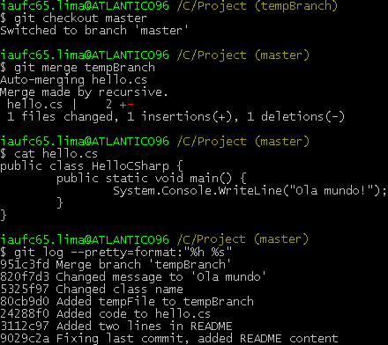
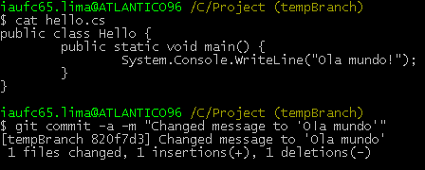
Merge
More complex merge

Slide 31

Hands on!
Tasks
Using the repository from previous exercise, verify if everything was added and commited
Modify the content of “fileOne” without add to the staging area
Run all types of diff and interpret the results
Add the modified file to staging area and run again all types of diff
Create a branch called “mybranch” and checkout
Add a file called “tempFile” in “mybranch”, put some text in and add to staging area
Modify “fileOne” again, add to staging and commit
Checkout “master” branch
Merge “myBranch”
Verify all files in directory and run log command

Slide 32
Clone
Copy an existing Git repository
Useful to share code
Command: $git clone [url]
Examples:
$git clone ssh://10.10.1.1/~/Repo.git
$git clone git://github.com/pjhyett/hw.git MyRepo
$git clone //10.10.1.2/Repo.git

Slide 33
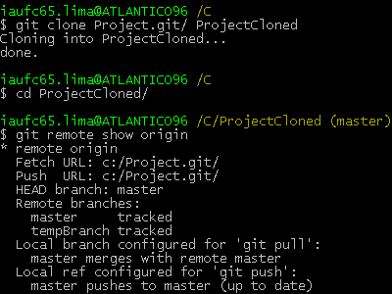
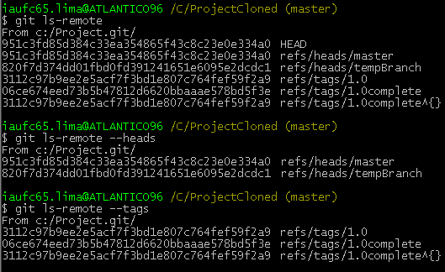
Clone
When you clone from a repository, it becomes a “remote” reference in you local repository
Default remote -> origin

Slide 34
Fetch, pull, push
Fetch: synchronize with a remote repository
$git fetch (remotename)
Pull = fetch + merge
Safe workflow example
$git fetch origin
$git merge origin/master
Push: push new branches and data to a remote repository
$git push remotename
$git push remotename branchname
$git push remotename tagname
$git push --tags

Slide 35


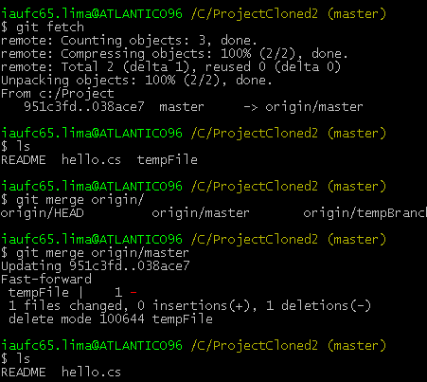
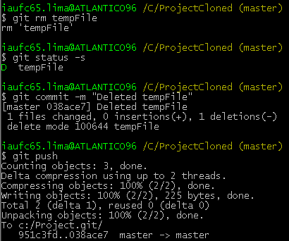
Fetch, pull, push

Slide 36
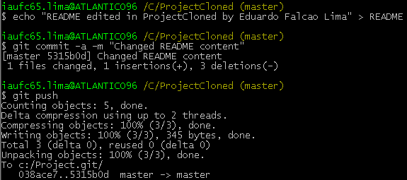
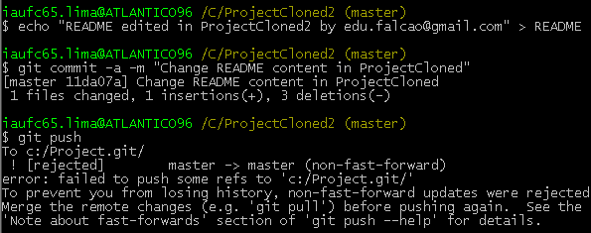
Fetch, pull, push

Slide 37
Reset
Set the current HEAD to the specified commit and optionally resets the index (staging area) and working directory to match
Git trees:
HEAD: last commit snapshot, will be the parent of the next commit
Index: proposed next commit snapshot
Working dir: sandbox (scratch space, used to modify file content)
“git reset is probably the most confusing command written by humans”
http://gitref.org/basic/#reset

Slide 38
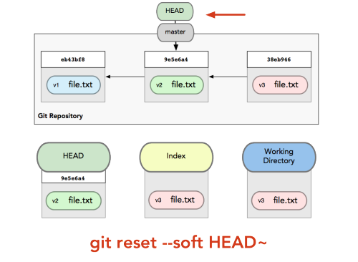
Reset
Soft reset

Slide 39
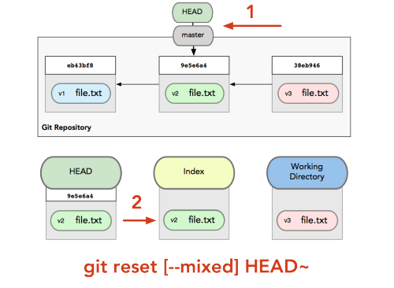
Reset
Mixed reset

Slide 40
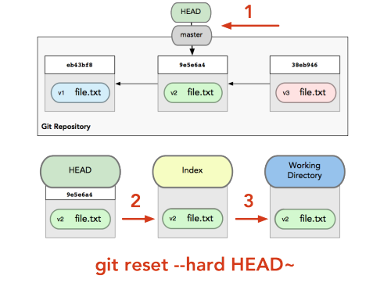
Reset
Hard reset

Slide 41

Reset
Live demo
The best explanation ever about reset: http://progit.org/2011/07/11/reset.html

Slide 42
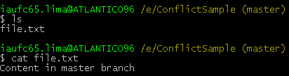
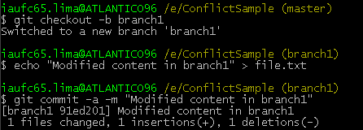




Conflicts

Slide 43

Hands on!
Tasks
Clone repository from ssh://great@computerIP/home/great/ObserverPattern.git
List local branches and remote branches
Run fetch and pull commands and verify result
Create a local branch
Push your new branch to the remote server
List remote branches to verify if your branch was pushed
In “master” branch, modify the message in ObserverOne.cs (line 17), add to staging area, commit and try to push
If a “non-fast-forward” error occurs, first fetch the remote changes, resolve the conflict locally and then try to push again
Modify ObserverTwo.cs and add to staging area
Reset the repository to leave modifications only in working dir
Reset again to leave repository in last commited state

Slide 44
Another useful commands
Revert -> undo last commit creating a new commit
Cherry-pick -> picking individual commits
Stash -> save status of work
Ref-log -> show all branch modifications
...
Useful links
http://gitref.org/
http://gitready.com
http://progit.org/book/

Slide 45



That’s all folks!
eduardolima@great.ufc.br
efalcaolima

